Slide 1
TEXT SUMMARIZATION

Slide 2
What is Text Summarization?
The technique, where a computer program shortens longer texts and generates summaries to pass the intended message, is defined as Automatic Text Summarization and is a common problem in machine learning and natural language processing (NLP).

Slide 3
Scope of the project- Need for Text Summarization Python
Various organisations today, be it online shopping, private sector organisations, government, tourism and catering industry, or any other institute that offers customer services, they are all concerned to learn their customer’s feedback each time their services are utilised. Now, consider that these companies are receiving an enormous amount of feedback and data every single day. It becomes quite a tedious task for the management to analyse each of these datapoints and come up with insights.

Slide 4
However, we have reached a point in technological advancements where technology can help with the tasks and we ourselves do not need to perform them. One such field that makes this happen is Machine Learning. Machines have become capable of understanding human language with the help of NLP or Natural Language Processing. Today, research is being done with the help of text analytics.
One application of text analytics and NLP is Text Summarization. Text Summarization Python helps in summarizing and shortening the text in the user feedback. It can be done with the help of an algorithm that can help in reducing the text bodies while keeping their original meaning intact or by giving insights into their original text.

Slide 5
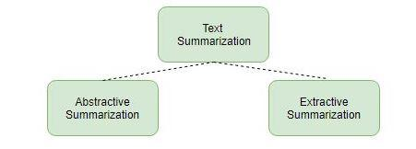
Approaches are used for Text Summarization
Extractive Summarization
Abstractive Summarization

Slide 6
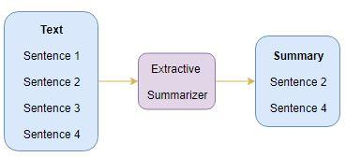
Extractive Summarization
In Extractive Summarization, we are identifying important phrases or sentences from the original text and extract only these phrases from the text. These extracted sentences would be the summary.

Slide 7
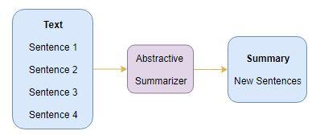
Abstractive Summarization
In the Abstractive Summarization approach, we work on generating new sentences from the original text. The abstractive method is in contrast to the approach that was described above. The sentences generated through this approach might not even be present in the original text.

Slide 8
Terms Used
Corpus A collection of text is known as Corpus. This could be either data sets such as bodies of work by an author, poems by a a particular poet, etc. To explain this concept in the blog, we will be using a data set of predetermined stop words.
Tokenizers This divides a text into a series of tokens. In Tokenizers, there are three main tokens – sentence, word, and regex tokenizer. We will be using only the word and the sentence tokenizer.

Slide 9
Stop Words
Words such as is, an, a, the, for that do not add value to the meaning of a sentence. For example, let us take a look at the following sentence:
EXAMPLE:
GreatLearning is one of the most useful websites for ArtificialIntelligence aspirants.
After removing the stop words in the above sentence, we can narrow the number of words and preserve the meaning as follows:
[‘GreatLearning’, ‘one’, ‘useful’, ‘website’, ‘ArtificialIntelligence‘, ‘aspirants’, ‘.’]

Slide 10
REQUIREMENTS :
python 3
tkinter module
pillow
nltk

